Slide 1


Python For The Parseltongues
Day 2
with
Sabbir Mollah
and
Mostafa Didar

Slide 2

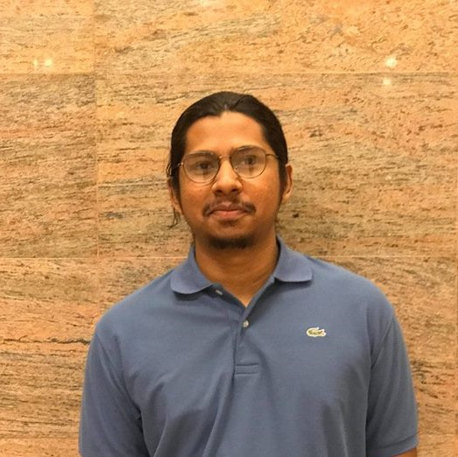
About the Instructors
Sabbir Mollah
Mostafa Didar
Is a rubber duck
Loves Chess and Star Wars
Previously worked as a Game Developer
Python enthusiast
Is a long haired Potato
Loves Writing , Music, Sports, anything that gets the creativity flowing
Actively involved in Data Science

Slide 3
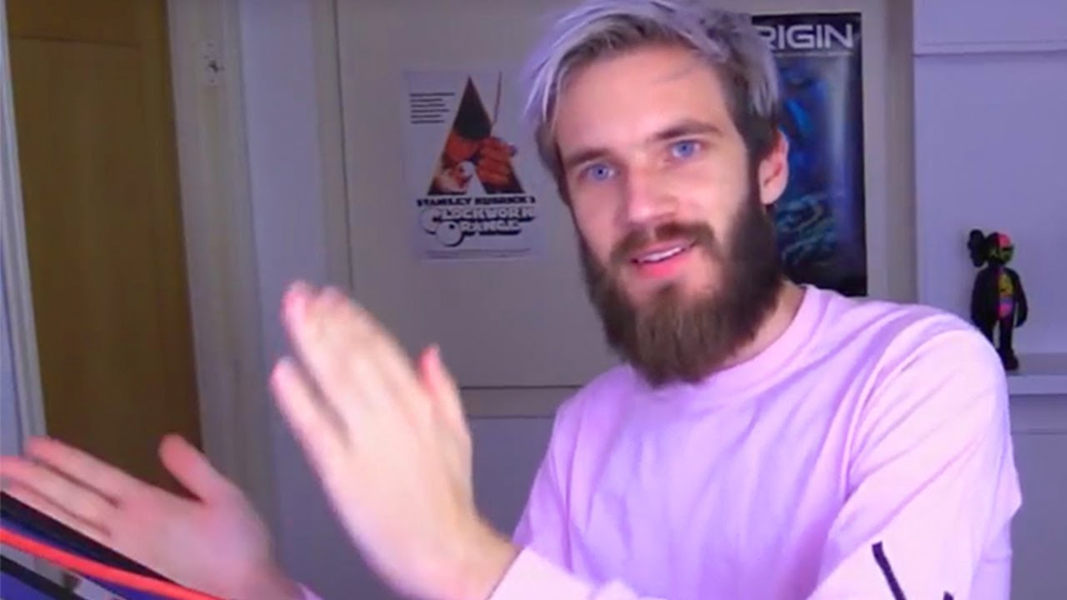
Review

Slide 4
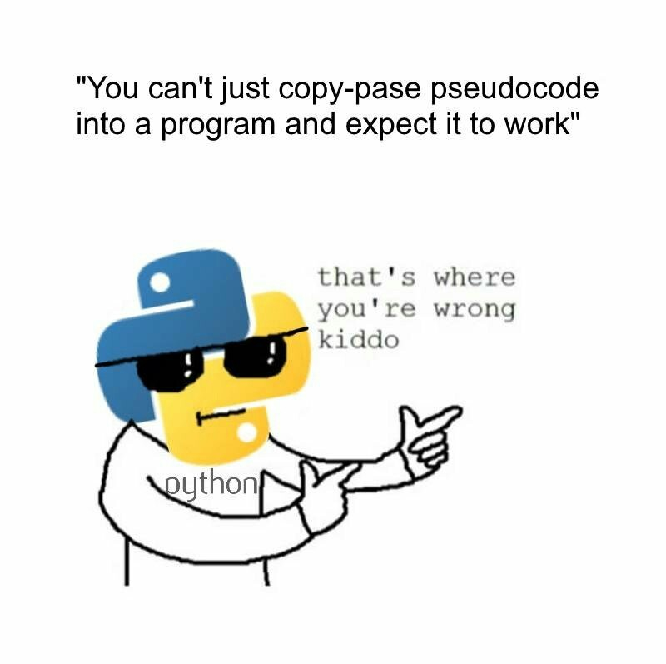

Slide 5
Write a Rock Paper Scissors Program
SHOW YOUR CREATIVITY!
HINT: TO GENERATE A RANDOM NUMBER:
import random
print( random.randint(0,2) )

Slide 6
Basic OOP
Basic Oopsie…?

Slide 7
Fields and behaviors
Instance variables - Class variables
Regular methods, class methods, Static methods

Slide 8
OOP Concepts
Inheritance
Polymorphism ...

Slide 9
News Crawler

Slide 10
Slide Reader

Slide 11
Thank you

